Slide 1

BookLand
Data Semantics for Arts
created by
Beatrice Venzano, Ilaria Gollo, Giulia Turri

Slide 2
why a virtual library?
Digital library provides many services
Instant access to catalogues and resources (access to data)
Fast Search Modes (Advanced and fast search tools - Customised filters and search options - Instant access to desired information)
Accessibility from any place and at any time (24/7 availability)
The public is increasingly digital, so a virtual library could be a more convenient solution for accessing information and knowledge.

Slide 3
targets
Offer a large and different collection of resources (novels including classic, modern and bestselling work)
Offer users the possibility of new experiences through interaction and the organisation of different kinds of events
Teachers and students who need access to educational resources
Generic readers who read and are interested in accessing a large collection of books and other stuff.

Slide 4
objectives
Unlimited access to resources
Optimising resource and service management processes through digitisation
Facilitate communication with the library with immediate assistance
Encouraging reading with many materials available on the website.

Slide 5
connections in the virtual library
Connection between user and library
Connection between user and event
Connection between user and book
Connection between book and event
INTERACTIONS BETWEEN LIBRARY, USERS, EVENTS AND RESOURCES

Slide 6
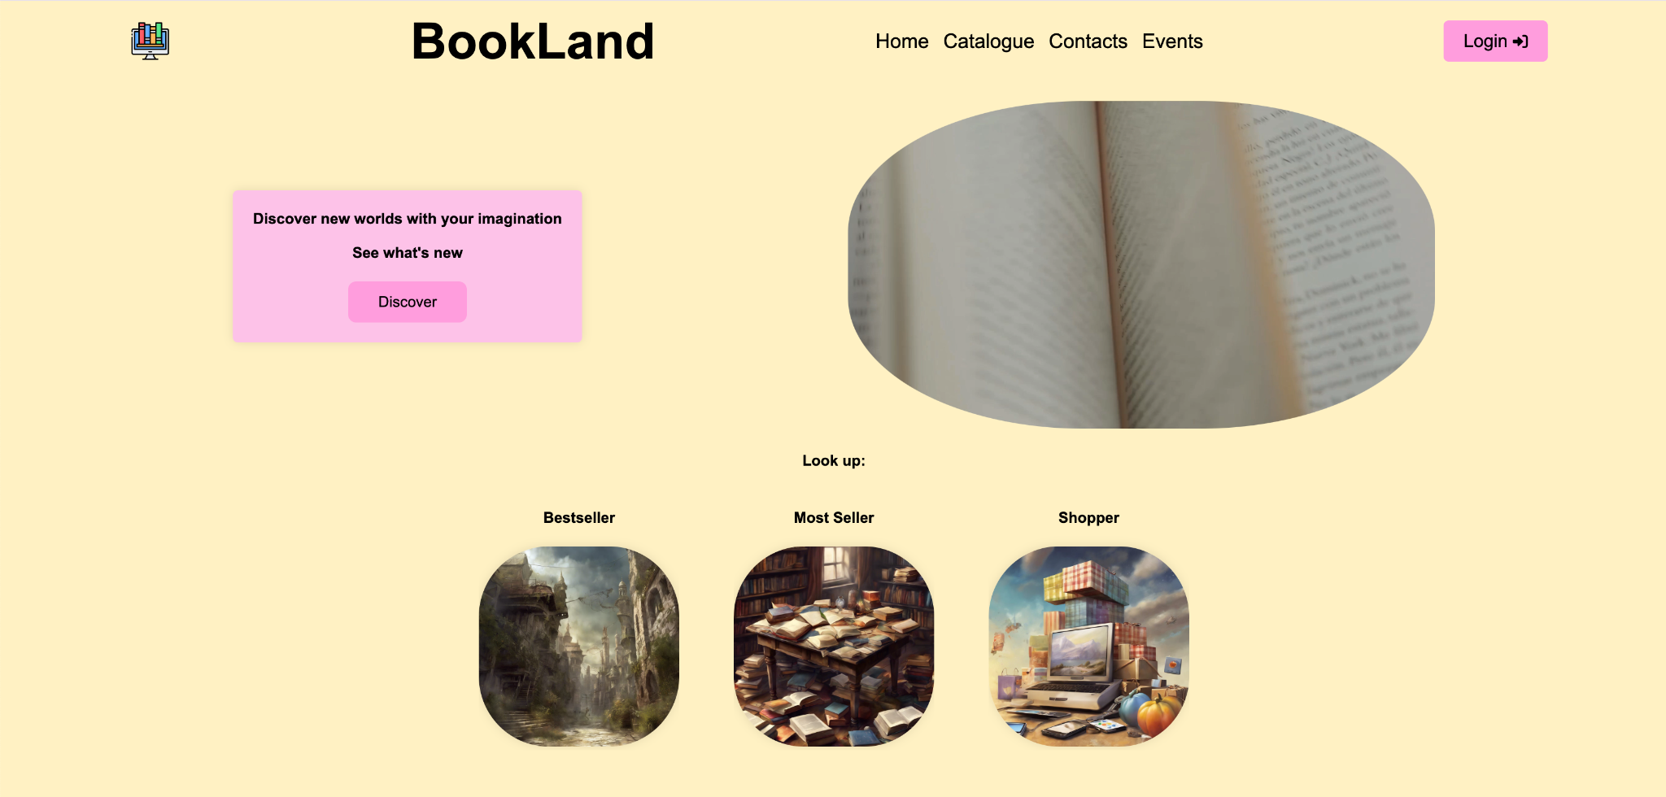
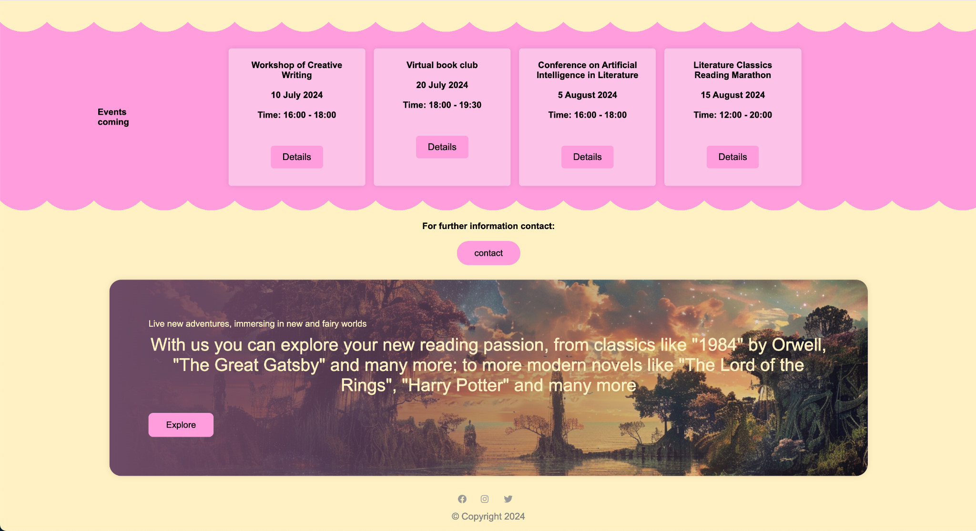
Main features
Home:
introduction to the website general information including available events

Slide 7
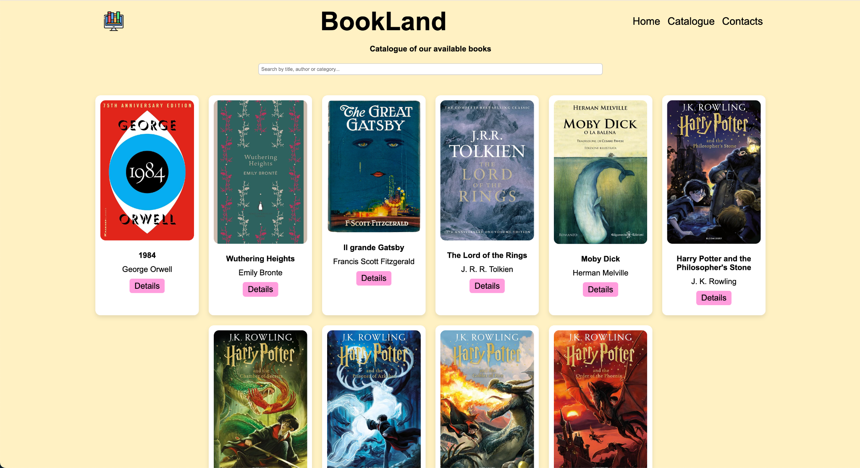
Main features
Book Catalog:
search and view of available books

Slide 8
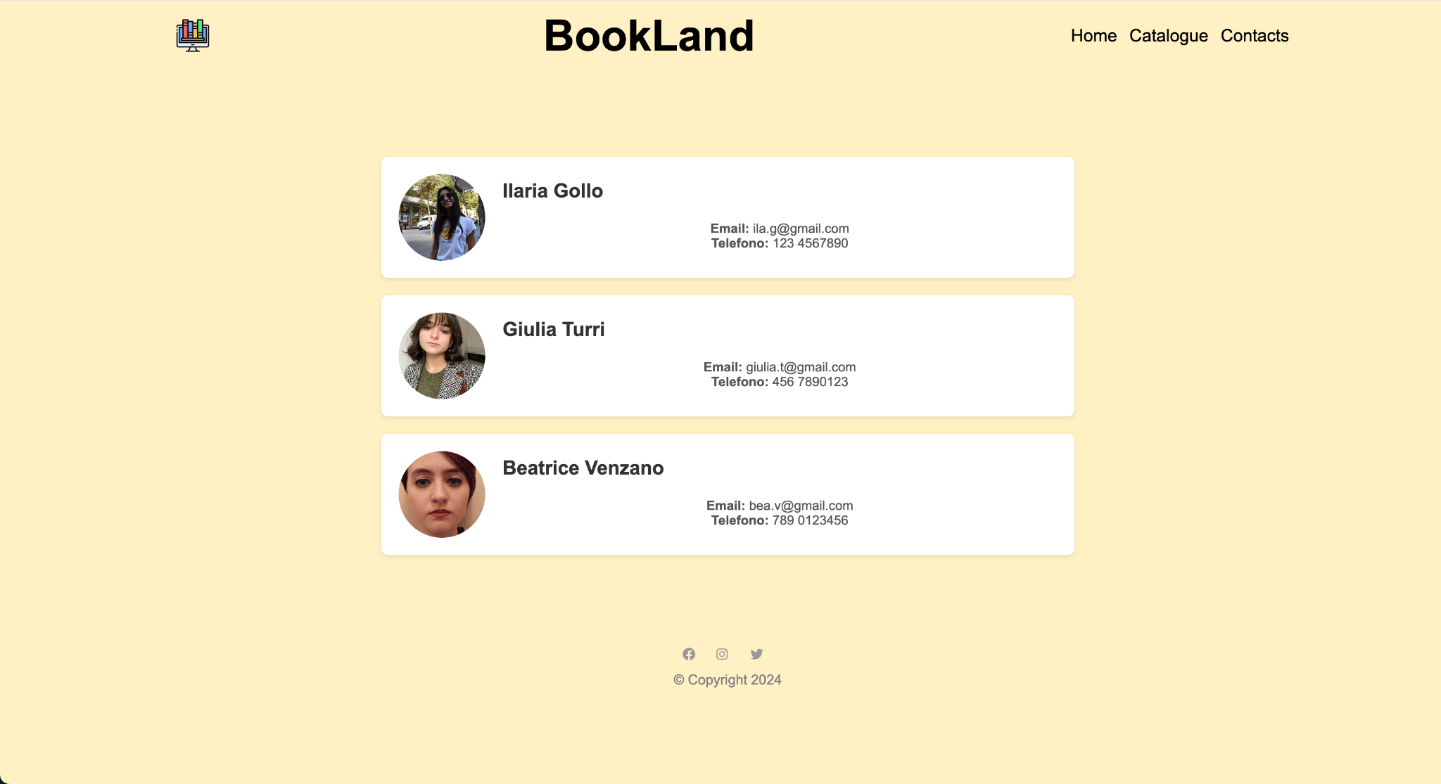
Main features
Contacts:
library contact information

Slide 9
tools used
Front-end:
HTML
CSS
JavaScript
Back-end:
RDF
SPARQL
Ontologies:
Dublic Core
Schema.org

Slide 10
Ontologies and vocabularies
Schema.org:
general annotation
Dublin Core:
specific annotation for the book
Event Ontology:
to structured event information

Slide 11

conclusions
The virtual library has given me access to resources that I could never have found in the local library. The convenience of being able to read anywhere, anytime is priceless!
Giulia R., University Student
Citations and positive feedback from users
subscribed to the virtual library…
An invitation to join our library:
Discover all the benefits of our virtual library.
Sign up today and start you digital adventure!
As a professional, I need to constantly update myself. The virtual library gives me access to a wide range of specialist journals and scientific articles, all at the click of a mouse.
Elena F., Medical Professional

Slide 12
CONCLUSIONS - NEWS AND UPDATES
Section dedicated to the latest news
Calendar with highlighted events
Ability to participate in surveys and give opinions
Continuous improvements based on user feedback
Updated mobile app for a better user experience.
Vision for the future:
Continuous innovation
Expansion of resources.

Slide 13
thanks for your attention

